Slide 1


Crunchy Corner Business Optimization & Budgeting
BY S S RASHMI ROUT

Slide 2


Module 01
Understanding The Business

Slide 3

About Company
Crunchy Corner is the Indias largest fast foods Restaurant chain and serving millions of costumers daily across various cities in India with more than 1000 restaurants and have largest SKU in the industry.

Slide 4
Client Requirements
Defining Problems
We are looking for Dashboard where we can check our Financial Performance, How we can Optimize our Business and Budgeting.
01
02
03
Financial Overview Metrices
Optimization of Business
Financial Planning & Budgeting

Slide 5
Module 02
Financial Performance Analysis

Slide 6
Financial Performance
Overall Sales, Gross Profit, EBITA, PAT, SKU
Show YOY sales of following ( Sales, Gross Profit, EBITA, PAT)
Trend of sales with PAT and PAT%
Show 100% stake column chart showing (Sales, Gross Profit, EBITA, PAT)
Show sales by Category and Location
Sales Bifurcation by Channel
Volume and Trend by Category

Slide 7
Module 03
Optimization of Business

Slide 8
Optimization of Business
Top category by Gross Profit & Net revenue ( Scatter plot)
Gross Profit and Volume comparison with Average (Dynamic)
Patero analysis (Level 1,2,3)
Show highest sales by category and % of SKU Contribution (Mekko Chart)

Slide 9
Optimization Steps
Quadrant Analysis
Quadrant Analysis to Identify Category, Sub Category high Contribution by sales & Gross Profit.
Quadrant Analysis to Identify Location high Contribution by sales and Gross profit
Step 1
Calculate Gross Profit Margin
Dax
Gross Profit = sum(Actual(Gross Profit))

Slide 10
GP Comparison
Gross Profit and Volume Comparison for Category
Step 1
Calculate Gross Profit Margin
Dax
Gross Profit = sum(Actual(Gross Profit))
Gross Profit = sum(Actual(Total Volume))

Slide 11
Pareto Analysis
Find out 20% SKU Contributing 80% of the Revenue
Pareto 1
Calculate
Total sales
Ranking of SKU by sales
Cumulative sales
Calculate Total SKU sales
Cumulative % = Cum/Total SKU sales
SKU Count
Cumulative SKU Count
Net SKU Count
Cum SKU %

Slide 12
Pareto 2
Calculate
Des SKU NR
Pareto 3
Calculate
Pareto Base
Pareto % Top N Revenue

Slide 13
Show Sales & %SKU
Mekko Chart
Meeko Chart is a type of data visualization that combines elements of bar charts and stacked bar charts to show data distribution across multiple dimension. It is particularly useful for displaying categorical data across different variables, where both the width and height of the bar represent different metrics.
Calculate
Total sales
%SKU Over Total SKU

Slide 14
Module 04
Budgeting Analysis

Slide 15
Budgeting Analysis
PVM Analysis
Variance Analysis
Actual vs Budget Financial Analysis for Business Drivers (Sales, EBITA, PAT, Volume) with Trend YoY
Actual vs Budget Financial Analysis Cost Drivers (COGS, Packing, Marketing) with Trend YOY

Slide 16
Budgeting Steps
PVM Analysis
PVM Analysis helps to understand the factors affected the business to increase or decrease
Step 1
Here we are showing Total amount of sales For the given Dates
Column Dax
Day = DAY(ListOfOrders[Order Date].[Date])
Calculated Measures
Sales by Day = calculate([Total Sales],groupby(ListOfOrders,ListOfOrders[Day]))

Slide 17
Module 4.1
Advanced DAX Function

Slide 18
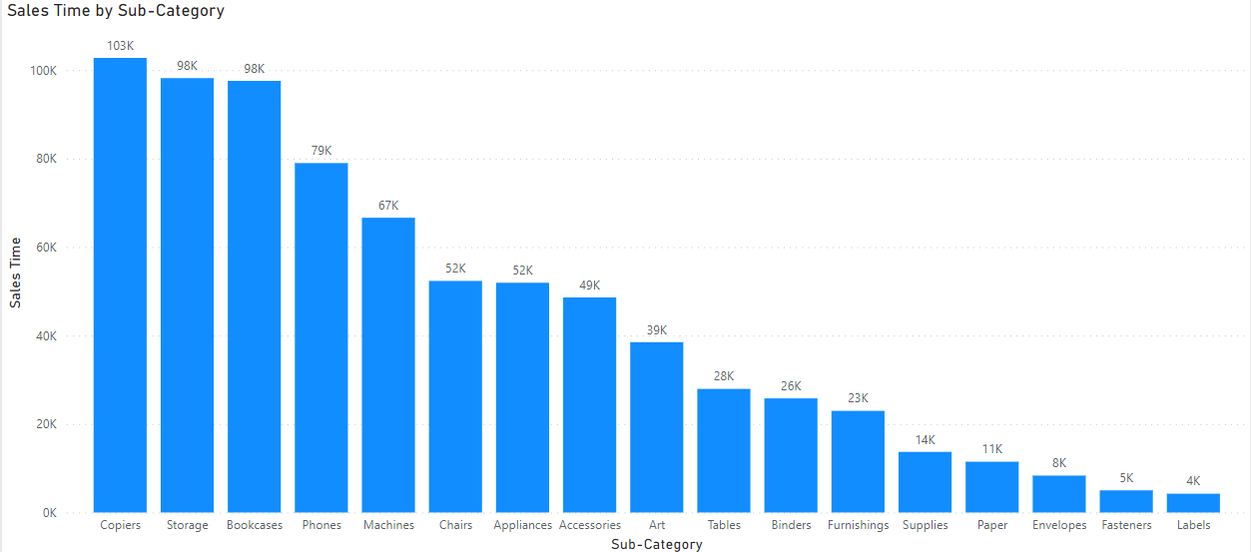
Advanced Dax
Calculate monthly ytd sales for each Sub Category
Selectedvalue function
Here we are showing monthly and ytd sales for each sub category
Calculated Measure
Sales Time =
IF(SELECTEDVALUE(Timeframe[Timeperiod])="Monthly",
SUM(OrderBreakdown[Sales]),
IF(SELECTEDVALUE(Timeframe[Timeperiod])="Ytd",
CALCULATE(SUM(OrderBreakdown[Sales]),
FILTER(all(ListOfOrders),ListOfOrders[Order Date]
<=MAX(ListOfOrders[Order Date])&&
ListOfOrders[Order Date].[Year]=
max(ListOfOrders[Order Date].[Year])))))

Slide 19
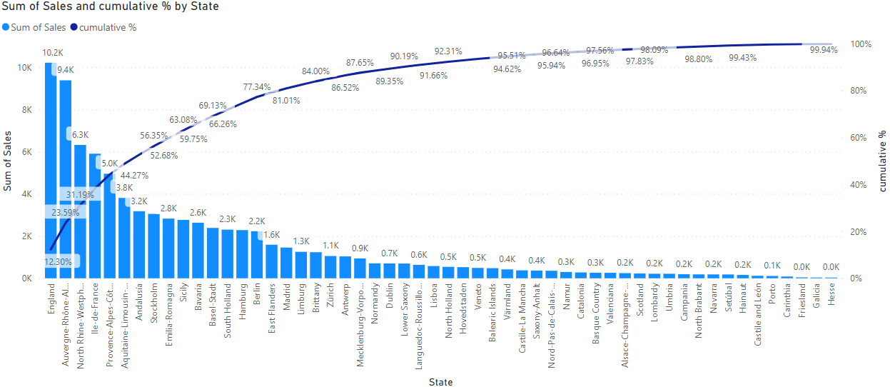
Cumulative Sales %
Calculated Measure
Cumulative% = Var sales = SUM(OrderBreakdown[Sales])returnDIVIDE(CALCULATE(SUM
(OrderBreakdown[Sales]),FILTER( ALLSELECTED(ListOfOrders[State]),
CALCULATE(SUM(OrderBreakdown[Sales])>=sales))),[All sales])

Slide 20
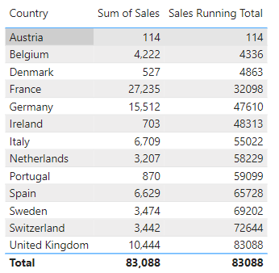
Running Total Sales
Calculated Measure
Sales Running Total = CALCULATE
([Sales Time],
FILTER(ALL(ListOfOrders[Country]),
ListOfOrders[Country]<=MAX
(ListOfOrders[Country])))

Slide 21
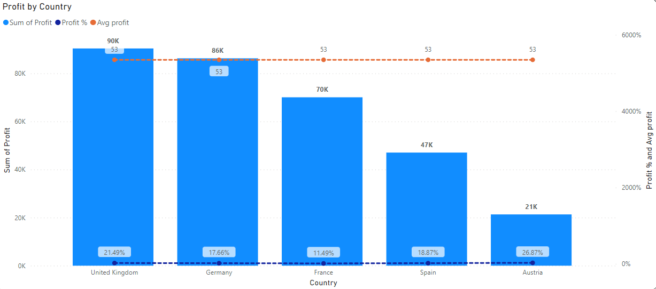
Top N Ranking
Calculating profit making top countries.
Calculated measure
Rank country =
Var A = RANKX(ALL(ListOfOrders[Country]),[Profit],,DESC)Var B = IF(HASONEVALUE
('Top N Country'[Top N Country]),MIN('Top N Country'[Top N Country]),20)Return IF(A<=B,1,0)

Slide 22
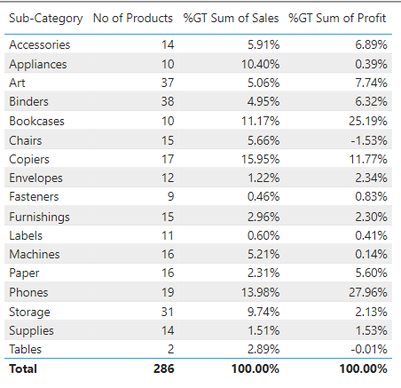
Product Contribution
Calculate sales and Profit contribution for each category
Here we are showing sales and profit
Contribution for each category.

Slide 23
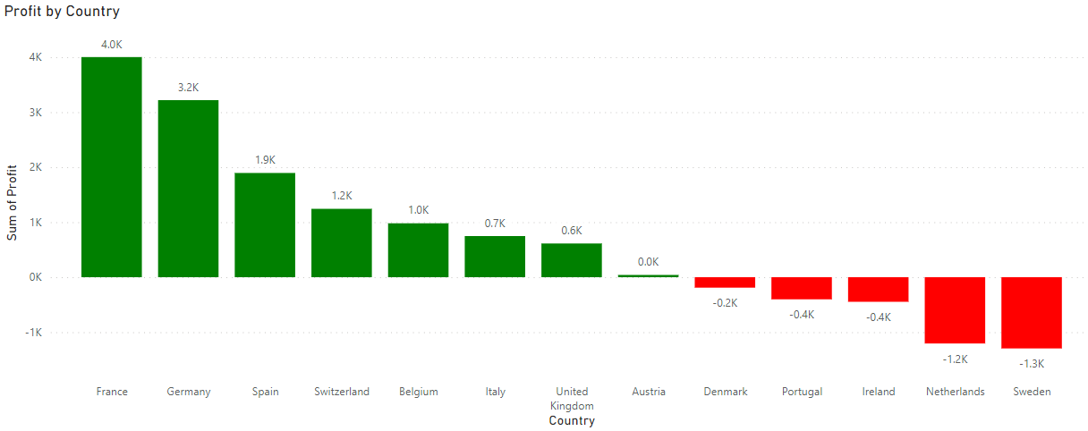
Conditional Formatting
Here we are showing Green bars for Positive profit and Red bars for Negative profit
Calculated Measure
Conditional formatting = IF(SUM(OrderBreakdown[Profit])>0,"Green",
IF(SUM(OrderBreakdown[Profit])<0,"Red"))

Slide 24
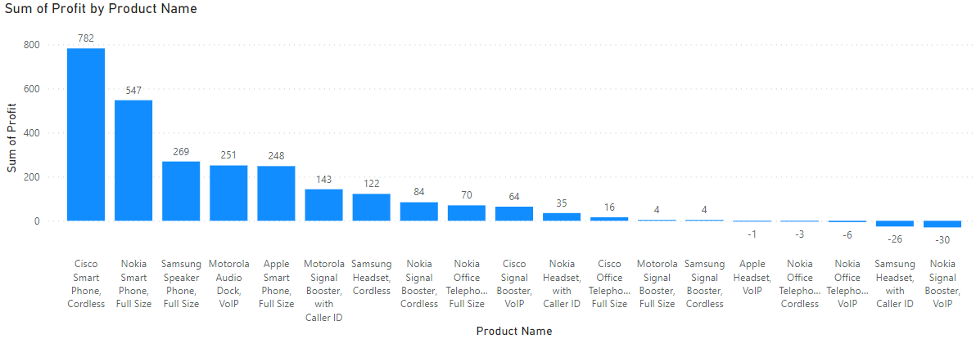
Active Products
Here we are showing total Active Products till date.
Calculate Measure
Active Products till date = IF (HASONEFILTER (OrderBreakdown[Product Name]),
IF (SELECTEDVALUE (OrderBreakdown[Product Name]) IN VALUES (OrderBreakdown [ProductName]), 1, 0 ),SUMX (VALUES (OrderBreakdown[Product Name]), CALCULATE (IF ( SELECTEDVALUE (OrderBreakdown[Product Name] ) IN VALUES (OrderBreakdown[Product Name] ), 1, 0 ))))

Slide 25
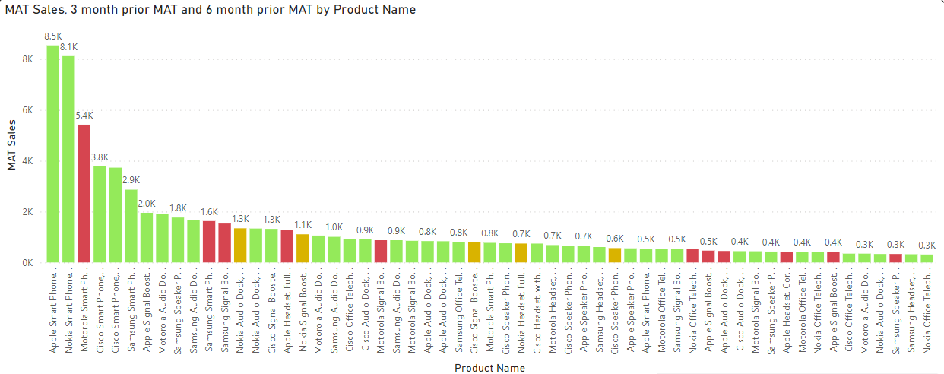
MAT
Here we are showing 3 months prior and 6 months prior MAT and highlight loss making and profit making products.
Calculate Measure
3 month prior MAT = CALCULATE([MAT Sales],
DATESINPERIOD(ListOfOrders[Order Date].[Date],
EOMONTH(MAX(ListOfOrders[Order Date]),
-3),-3,MONTH))
MAT conditions =
IF([MAT Sales]< [6 month prior MAT],1,
IF([MAT Sales]< [3 month prior MAT],2,3))

Slide 26
Thank You

